Slide 1

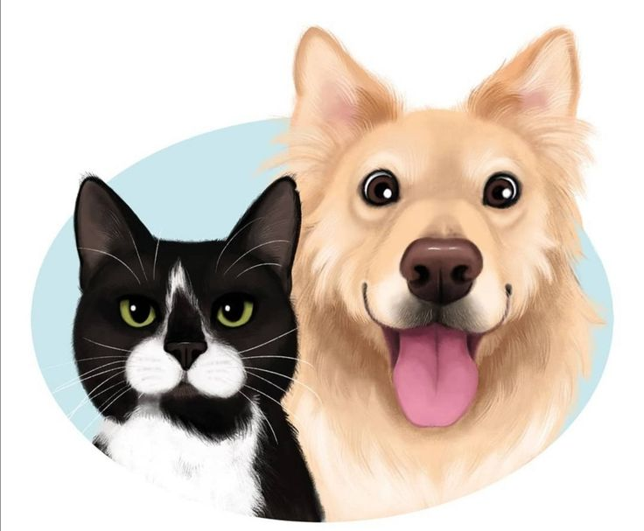

Pet Shop Web Application
Presented By
Pratik Sawant & Uddesh Deshmukh

Slide 2
Introduction
The main purpose of developing the "Pet Shop web application" is to provide a digital platform designed to facilitate the buying, selling, and management of pets and pet-related products. It serves as an online marketplace where pet enthusiasts, pet owners, breeders, and pet product vendors can interact, showcase their offerings, and make transactions.
The objective of the Pet-Shop Web Application is to create a user-friendly and effective platform for customers to easily browse and buy products related to pets. The application strives to ensure a smooth and hassle-free shopping journey, allowing users to discover an extensive variety of pet products and complete their purchases online with ease

Slide 3
Technology Used
We used Java Spring-Boot as backend and React JS as Frontend in our Project.
Spring-Boot :– The primary objective of the Spring Boot framework is to minimize development time while enhancing efficiency. React has emerged as the preferred choice for front-end development due to its provision of a virtual browser environment, which is more user-friendly than a physical browser. Moreover, JavaScript developers can quickly transition into productive developers within a short span, thanks to the framework's concise API, a handful of functions, and their practical applications.
React :– React enables developers to build expansive web applications capable of modifying data without requiring a page reload. Its core objectives are speed, scalability, and simplicity. This sets it apart from Spring.

Slide 4



User Classes
Order
Customer
Product
User
The Customer class is a specific type of user, tailored to represent customers of your pet shop. It could have properties
The Product class represents the items available for sale in your pet shop. Each instance of this class could correspond to a particular product type, such as pet food, toys, accessories, etc
The User class represents individuals who interact with your web application. In the context of your pet shop, users could be customers, administrators, or other roles.
The Order class encapsulates the information related to customer transactions within your pet shop web application. It plays a crucial role in tracking and managing the purchase process. Here's a more detailed breakdown of its properties and functionalities

Slide 5
Application Functions
01
Effortless Product Exploration: Simplifying the process, users effortlessly discover a wide range of pet products with intuitive search and filters.
Streamlined Checkout Experience: Users smoothly select, learn about, and purchase products, minimizing complexity.
02
Personalized User Profiles: Individual profiles store order history and preferences for tailored shopping.
03
Empowering Admin Dashboard: Administrators effectively manage orders, inventory, and customer insights from a robust dashboard.
04
05
Efficient Order Control: Admins easily handle order statuses, cancellations, returns, and customer communication.
06
Effortless Order Placement: Users easily place orders for desired pet products.

Slide 6
Application Provide Modules
Petshop WebApplication, implemented fundamental CRUD operations for customer orders, enhancing the shopping experience
Create: Pet enthusiasts can create new orders by adding desired pet products to their cart and proceeding to checkout, seamlessly initiating the purchase process.
Read: Customers gain insight into their pet shopping history, accessing a record of past orders that showcases product details, quantities, and overall expenses.
Update: Empowering customers, the application allows order adjustments pre-checkout. Quantities can be modified, items removed, and even orders canceled if they haven't advanced to shipping or delivery stages.
Delete: Customers retain control by enabling order cancellations prior to shipment. Removal of orders from history synchronizes with inventory updates.

Slide 7
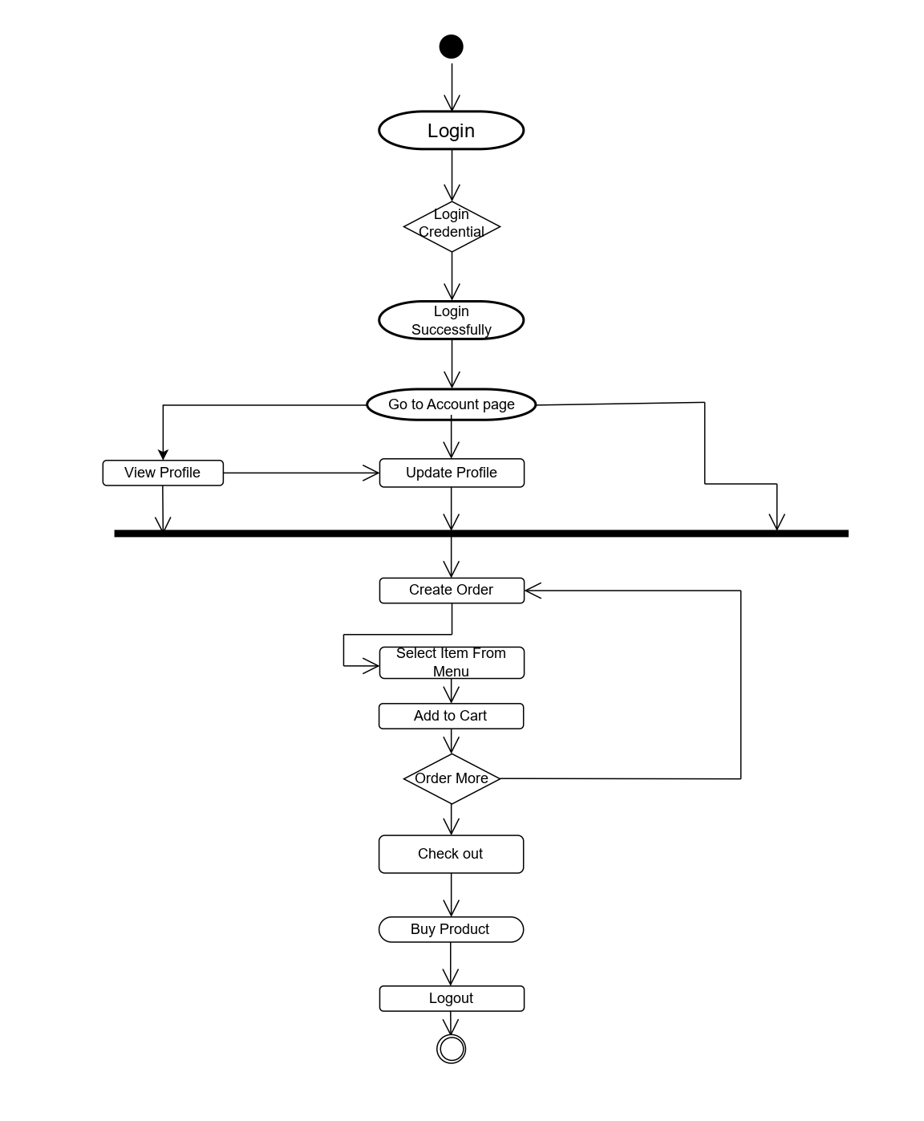
Application Activity Diagram

Slide 8
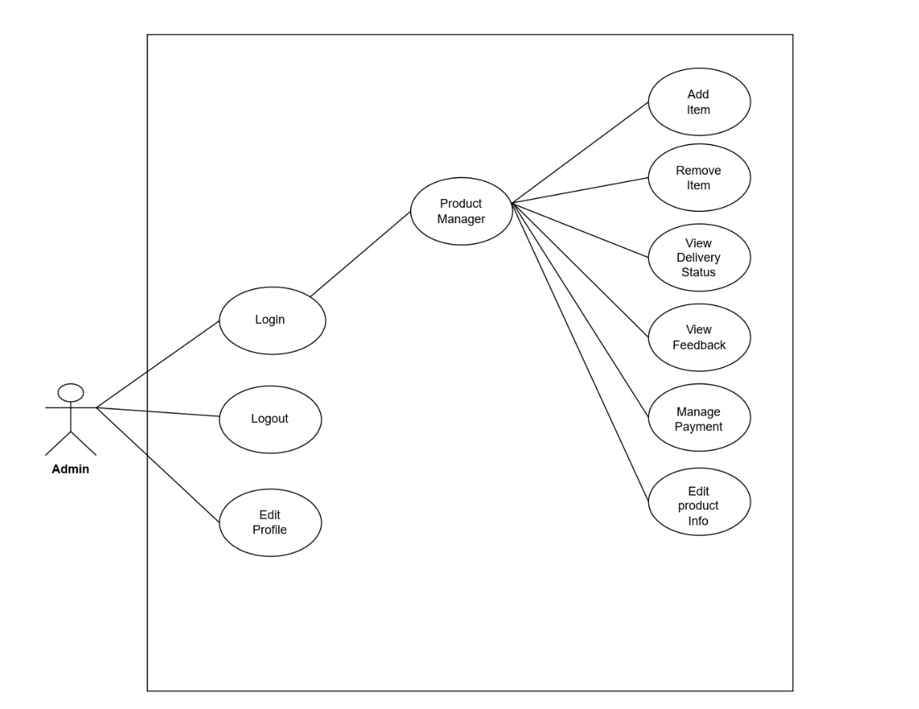
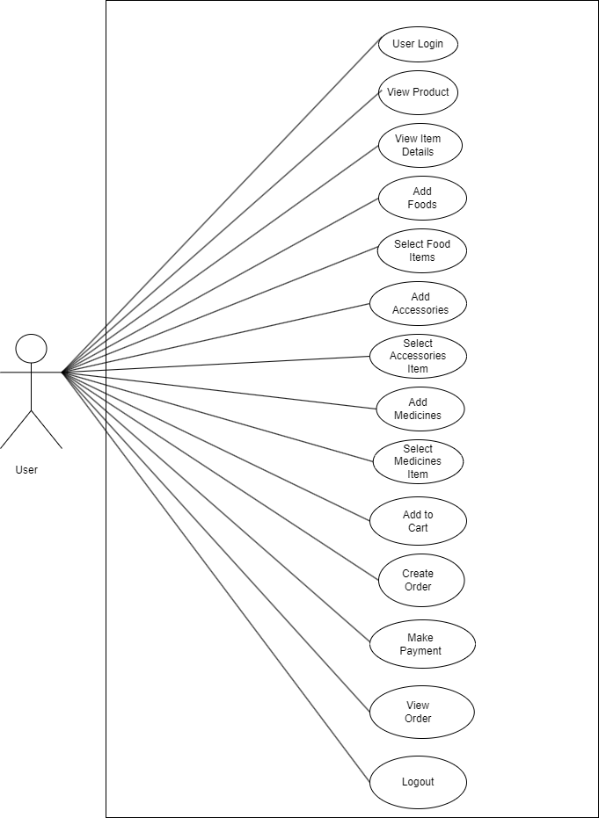
Admin side use case Diagram

Slide 9
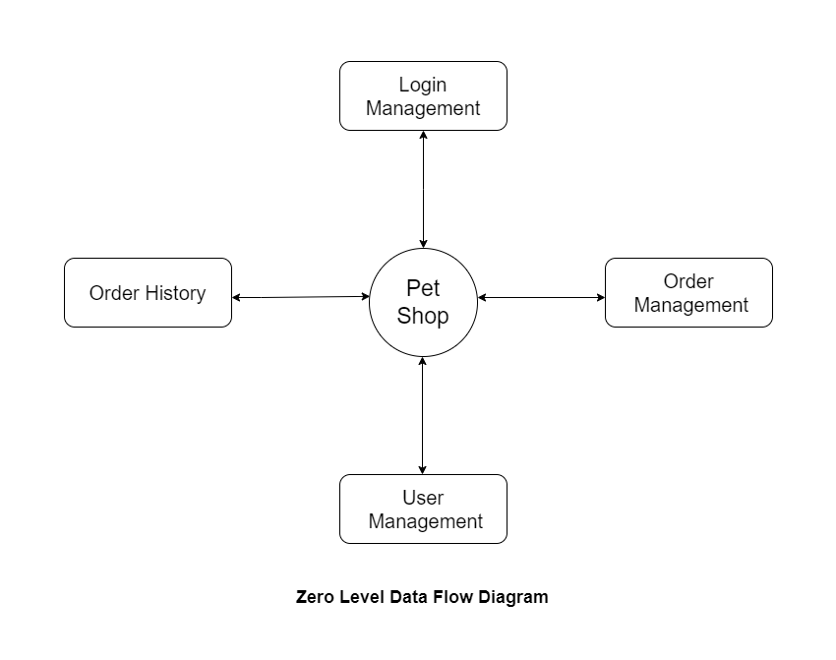
Zero Level Data Flow Diagram

Slide 10
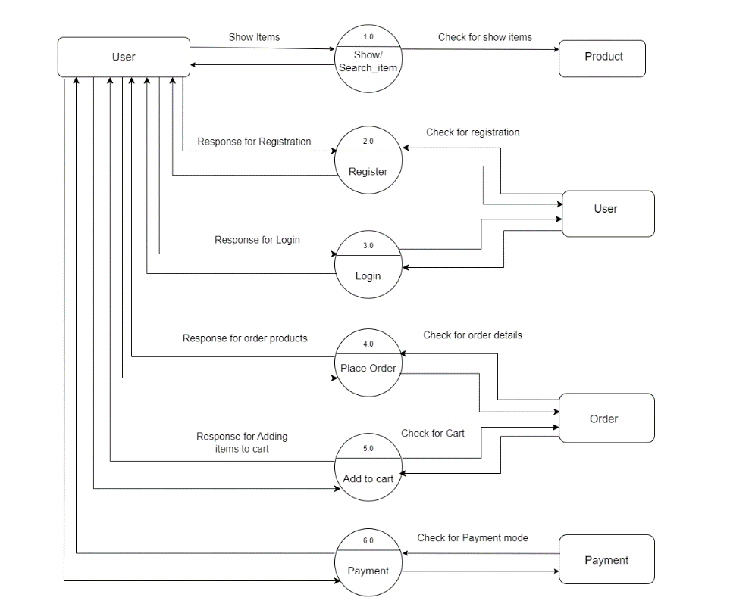
1st Level Data Flow Diagram

Slide 11
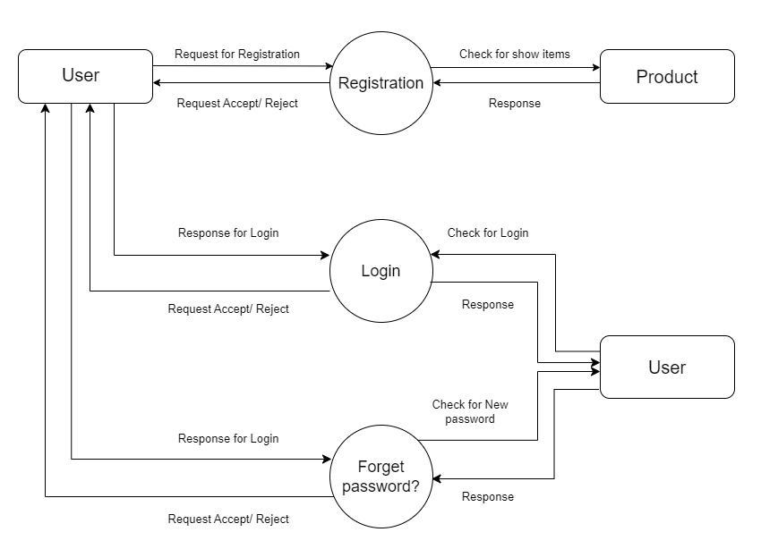
2nd Level Data Flow Diagram

Slide 12
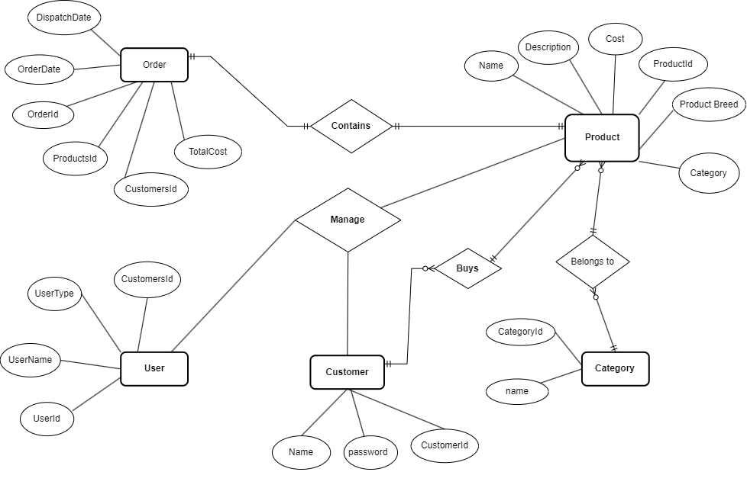
Entity Relationship Diagram

Slide 13
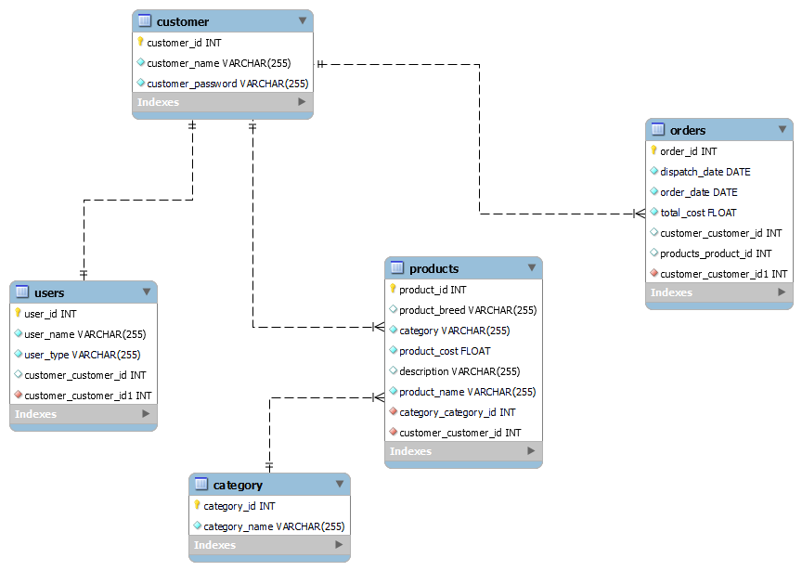
Class Diagram

Slide 14
